Slide 1
Regular expressions
Ronnie Holm
Lecture 10

Slide 2
Agenda
What are regular expressions?
Regular expression basics
Character sets
Quantifiers
Groups

Slide 3
What are regular expressions?
Domain specific language for describing patterns in strings
Useful for validating user input
Useful for extracting substrings in a string
Useful for replacing substrings in a string

Slide 4
Regular expression basics
Regex.Match is a more powerful version of the String.IndexOf method
Regex.Match searches for pattern rather than literal string
static void Main(string[] args) {
Console.WriteLine(Regex.Match("color", "colou?r").Success); // true
Console.WriteLine(Regex.Match("colour", "colou?r").Success); // true
Console.WriteLine(Regex.Match("colouur", "colou?r").Success); // false
}
static void Main(string[] args) {
Match m = Regex.Match("any color you like", "colou?r");
Console.WriteLine(m.Success); // true
Console.WriteLine(m.Index); // 4
Console.WriteLine(m.Length); // 5
Console.WriteLine(m.Value); // color
Console.WriteLine(m.ToString()); // color
}

Slide 5
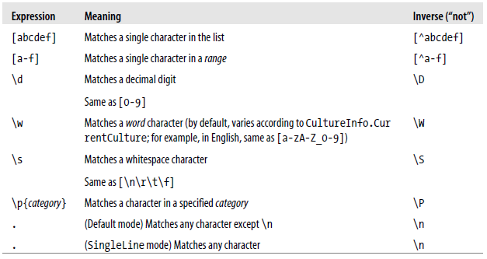
Character sets
Console.Write(Regex.Matches("That is that.", "[Tt]hat").Count); // 2
Console.Write(Regex.Match("quiz qwerty", "q[^aeiou]").Index); // 5
Console.Write(Regex.Match("b1-c4", @"[a-h]\d-[a-h]\d").Success); // true

Slide 6
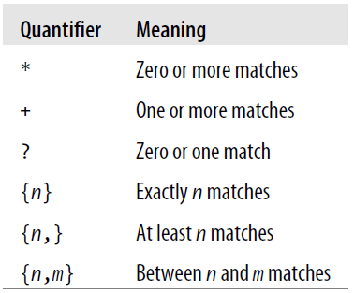
Quantifiers
Console.Write(Regex.Match("cv15.doc", @"cv\d*\.doc").Success); // true
Console.Write(Regex.Matches("slow! yeah slooow!", "slo+w").Count); // 2
Regex bp = new Regex(@"\d{2,3}/\d{2,3}");
Console.WriteLine(bp.Match("It used to be 160/110")); // 160/110
Console.WriteLine(bp.Match("Now it's only 115/75")); // 115/75

Slide 7
Groups
Separate a regular expression into a series of subexpressions
consider the following regular expression that represents a
U.S. phone number such as 206-465-1918
Match m = Regex.Match("206-465-1918", @"(\d{3})-(\d{3}-\d{4})");
Console.WriteLine(m.Groups[0]); // 206-465-1918
Console.WriteLine(m.Groups[1]); // 206
Console.WriteLine(m.Groups[2]); // 465-1918

